Slide 1
Case Study
New Style Forecasting

Slide 2



Business Background and Objectives
Background & Objective
The client, a leading American multinational sportswear brand wants to predict unit sales of new styles (Cold Start) across various geographies to arrive at optimal inventory
They want to create better approach towards New style trend forecasting by leveraging Image recognition capabilities. Hence, match new styles to existing styles to replicate sales trends
Solution Framework
Business Impact
Image Classification
Image detection/ classification model, using deep learning techniques like CNN,DCIGN, to identify and match the new styles based on the color, features & design
High Efficiency – Reduced manual interference in the estimation of repair costs due to automated process in place leading to increase in speed and higher efficiency
Accurate Forecasting – Improved forecasting accuracy by better matching of styles through Image recognition engine. Hence better product planning and inventory stocking
Sales Trend Replication
Replication of forecasts of Sales trends based on matched styles from Image classification engine
AFFINE CONFIDENTIAL
<number>
Notes:
<number>

Slide 3

Image classification algorithm to identify similar style
Image Classification
Sportswear
Footwear
Apparel
Accurate Process
Product Categories
Sales
Trend
Improved Forecasting
Style
Design
Color
Higher Accuracy
Product attributes
AFFINE CONFIDENTIAL
<number>
Notes:
<number>

Slide 4
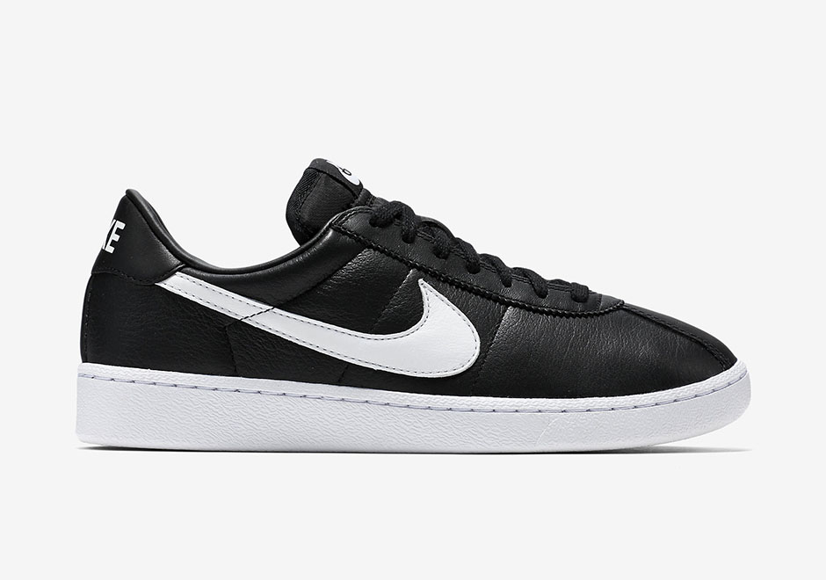
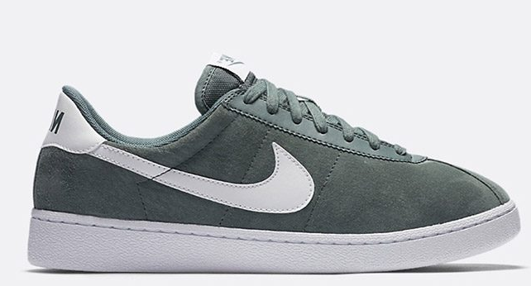
Analytical approach to implement the Forecasting Engine
Create Databank
Train & Validate Model
Identify Sales Trends
Databank will include both historical and newly designed styles and labelled accordingly. Size 256*256 pixels
New styles will be classified based on similarity of color, style & features
Sales Trend can be replicated based on matching styles & features of matched styles from image recognition engine.
Training Data
Historical
New Design
Supervised Image Classification Model using Deep Learning CNN
– ConvNet, AlexNet, Fast R-CNN etc.
New Style
Similar Style From CNN
Styles
Identify Similar Styles
Develop Hyperparameters – Shift Rate, Epoch, Seeds for weights
Style
Silhouette
Pre-label datasets
Measure accuracies w.r.t validation data e.g. Sensitivity vs. Specificity
Sales Trend
Color
Assign weights
Price
AFFINE CONFIDENTIAL
<number>

Slide 5
*CNN techniques will be applied to measure damages
C1
P1
1
ReLU
C2
C4
P2
2
SoftMax
Matching Style 1
C3
3
L_{N} -BN
…L_{n-1}
N-1
L3-BN
Matching Style 2
Dropouts
L2
N
L_{n+2}
L1-BN
…L_{n+1}
Input Image
C(x) – CNN
L1,L3..– CNN Layers
P(x) – Pooling
L2,L4..– Pooling Layers
BN-Batch Normalization
Dropouts
Input Image
Convolution
Non Linearity - ReLU
Pooling
Dropouts
Input holds raw pixel values of the image
Features being width, height & RGB values
Conv Net is to extract features from input data
Formation of matrix by sliding filters over an image and computing dot product is called “Feature Map’
This layer applies element wise activation filter.
Leveraged to simulate non-linearity relationships in a standard ANN
Reduces the dimensionality of each feature map and retains important information
Helps in arriving at an scale invariant representation of an image
To prevent overfitting random connections are severed
Output layer, classifies matching style based on probabilistic functions
SoftMax Layer
AFFINE CONFIDENTIAL
<number>

Slide 6
Infrastructure for Image Processing
GPU computes much faster than CPU.
GPU's are more specialized at performing matrix operations
and other advanced mathematical transformations
GPU executes 10x speed than CPU

Slide 8


